Slide 1
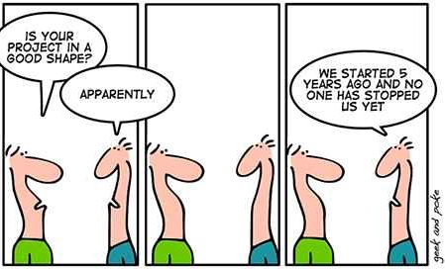
Monitoring and evaluation plans and how to go from zero to hero
Craig Leisher
Notes:
You may be new to monitoring and evaluation or may know a bit about it, but by the end of this training today, you will know the principles and good practices for developing a Monitoring and Evaluation Plan, and I will introduce you to a template that makes developing a Monitoring and Evaluation Plan much easier. Together, these will allow you to quickly go from "zero to hero" when writing a monitoring and evaluation plan.

Slide 2
Overview of an M&E Plan
THE NATURE CONSERVANCY
2
Notes:
Let’s start with an overview of what’s in a monitoring and evaluation plan. Note the top-level headings here. A monitoring and evaluation plan has a summary, an introduction, and a theory of change. It then looks in-depth at monitoring, evaluation, and learning before detailing the responsibilities, timeline, and budget for monitoring and evaluation. We will cover these headings in more detail later, but first, let’s take a step back and look at why we do monitoring and evaluation in the first place.

Slide 3
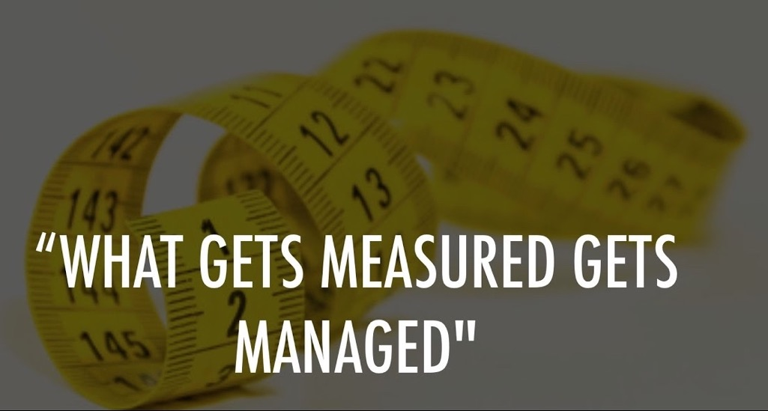
Why do monitoring and evaluation?
  Monitoring and Evaluation enables:
  Managing for outcomes
  Adaptive management
  Accountability
  Learning
  Improved outcomes
  Replication
Notes:
At TNC, we do monitoring and evaluation because it enables managing for outcomes, adaptive management, accountability, learning, improved outcomes, and replication. Roughly in that order in fact. Here are some words to walk away with: what gets measured gets managed. This is the single best answer to why M&E: because what gets measured gets managed. Any questions on why we do monitoring and evaluation?

Slide 4
How do I find the money to fund M&E?
Build M&E in at project design stage and budgeting
Key is to get one person in the BU who can build M&E into new project designs and proposals
Fund this first M&E person from unrestricted funding
Takes several years but then it is largely self-sustaining
THE NATURE CONSERVANCY
4
Notes:
Here’s the first principle of monitoring and evaluation (or M&E) I want to touch on: How to fund M&E in the longer term. The key to funding M&E work is building it in during the project design and budgeting. In recent years, the Africa region of TNC has been able to build a lot of M&E capacity because the region has one person who ensures M&E gets built into every new project design and budget. It took the Africa region several years to build a pipeline of M&E funding but once the M&E “pump” is primed with a lead M&E person, it can be self sustaining in the longer term.

Slide 5
How much should I invest in M&E for a project?
Approximately 10% of total project costs should be earmarked for monitoring and evaluation.
THE NATURE CONSERVANCY
5
Notes:
This brings up the question, how much should I invest in M&E for a project? The short answer is about 10% of the total project cost. If you want to read the longer and more accurate answer, I will put a link in the chat:
https://tnc.box.com/s/lwwhfh4qr1n71zyghfa1kmyn9ki195a4
10% is a rule of thumb. If you invest 10% of total project costs in M&E, this is sufficient for most project unless they are really large or really small projects. Really large project will need less than 10% and really small projects will need more than 10%. Any questions on how to fund M&E work or how much to invest in M&E?

Slide 6
Should I buy or build M&E capacity?
Buy M&E capacity by hiring contractors to do the work
  Quickest way to get M&E started
  Ends when the project ends
  Contractors take the learning with them
  May do only the minimum to save costs
Build M&E capacity by hiring staff to do the work
  Takes longer but builds in-house M&E capacity
  Learning from project and project adaptive management are stronger
  Helps the BU and TNC get better at M&E
THE NATURE CONSERVANCY
6
Notes:
Here’s our second principle of M&E: decide if you will buy or build M&E capacity. Once a team has funds for M&E, there are pros and cons to buying M&E capacity by hiring a contractor to do the work versus building M&E capacity by hiring staff. Buying M&E capacity is the quickest way to get started on monitoring and evaluation work, and the obligation to pay for M&E usually ends when the project ends. But the M&E contractors take their learning and knowledge with them, and some contractors can be focused on maximizing their profits, so they do the minimum M&E so they can save costs. In my experience, when hiring contractors to do M&E, quality is often an issue and project learning and adaptive management are much harder to do. Building M&E capacity by hiring staff takes more time, but it builds long-term capacity. It also shortens the feedback loops for project learning and adaptive management because the M&E person is already part of the project team. Our default choice at TNC should be to build M&E capacity wherever possible. This will made us a stronger and better organization. So build rather than buy if you have the option. Any questions on this?

Slide 7

Building in Equity
M&E needs to fully align with TNC core values, especially integrity beyond reproach and respect for people, communities, and cultures.
If working with a local community or indigenous people, FPIC and Human Rights Guide (www.tnchumanrightsguide.org/)
Develop indicators in collaboration with the local community
Human Subjects Research
Benefits to control groups
Disaggregated people data collection for sex and age
THE NATURE CONSERVANCY
7
Notes:
I have a whole slide on building in equity. It should be part of everything we do. We need to do FPIC whenever we are working with local communities or indigenous peoples. FPIC stand for: free, prior and informed consent. But here’s how you make FPIC far better: change consent to collaboration so that is is free, prior and informed collaboration. It's a partnership in other words! This will be far more socially sustainable than mere consent. That's the first point. The second point is develop indicators in collaboration with the local community. The people closest to the outcomes will be the best judge of what’s viable. If the team is doing a household survey or focus group discussions, they need to get Human Subject Research clearance from the Office of the Chief Scientist. This usually takes a day or two and the forms on are Connect. If the team chooses an evaluation design that includes control communities, they need to ensure that control groups benefit from the project in some way. Finally, we should always disaggregate all the people data we collected by sex and age. We want to ensure our projects don’t make certain people, like female-headed households or the elderly, worse off. As mentioned at the beginning of the call today, our new human rights guide is an excellent resource when thinking about equity. Any questions on building in equity.

Slide 8
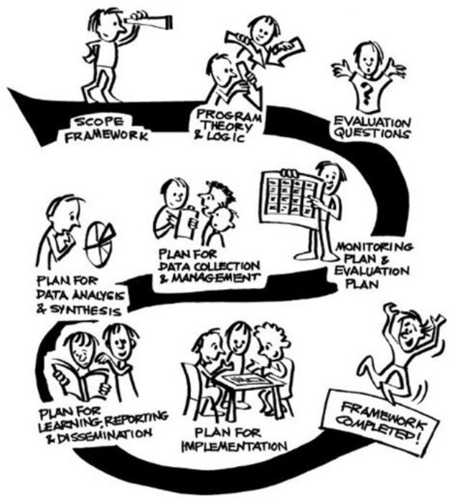
M&E process ->
Source: Markiewicz & Patrick 2016
THE NATURE CONSERVANCY
8
Notes:
Now let’s look at the M&E process itself. While TNC does not have specific guidance on the M&E process or the “framework” as they call it in this illustration here, the steps you see here are widely followed. Start with defining the scope of the M&E: how much funding is available and for how many years. Then develop your theory of change. After this, you define one or more evaluation questions you want to answer at the end of the project. You then develop a monitoring and evaluation plan that includes data collection and management, data analysis, learning, reporting and dissemination, and an implementation plan for the M&E work. This is the process used by many organizations for creating Monitoring and Evaluation Plans. Any questions on the process?

Slide 9
4 lethal mistakes in M&E
Poor communication between partners
Vague project goal and/or poor evaluation design
Failure to turn data into information
Failure to act on and not just review the information
THE NATURE CONSERVANCY
9
Notes:
About 3 years ago, I was the lead author of a guide to monitoring and evaluating water funds. The guide’s co-authors had a combined 124 years of monitoring and evaluation experience. We synthesized all these years of experience into the 4 most common mistakes that can kill monitoring and evaluation efforts. The first is one I’m sure you all know to avoid: poor communication between partners. The second is a vague project goal and/or poor evaluation design. If the goal of the project is not clear or the project has many goals, it is hard to know what to evaluate. So nothing gets evaluated, or the wrong things get evaluated. Also, project teams need to decide on the evaluation design upfront and document this in the M&E Plan. The last two lethal mistakes are related. The first is failure to turn the data collected into usable information. The second is even once the data are turned into usable information, project teams need to act on this information by adaptively managing project activities. There is often inertia on teams to keep doing the same activities rather than look at the M&E information and potentially change how activities are implemented. We talk about adaptive management, but for a variety of reasons, not a lot of projects actually do adaptive management. If you can avoid these 4 mistakes, your chances of having a project with excellent outcomes is high. Any questions on this?

Slide 10
What is an output and what is an outcome?
Break into small groups
Review a jumbled list of M&E outcomes and outputs
Sort the list into outcomes and outputs
THE NATURE CONSERVANCY
10
Notes:
Now we are going to break into small groups for 10 minutes. The link to the exercise be in the chat in a moment. I want you to look over a jumbled list of 15 outcomes and outputs and decide which is an outcome and which is an output. Outcomes are the high-level things we want to achieve like the 17 SCA Organizational metrics that underly TNC’s 2030 Goals. Outputs are deliverables that contribute to the outcomes. I will put the link to the exercise in the chat.
https://tnc.box.com/s/3ljmb1lj4fgp964mhg6qo80b2uyvqjfj
Any questions on this?

Slide 11
Tools & Resources
GUIDES
TNC Water Funds M&E guide (English, Spanish, Portuguese)
PRISM M&E guide
TNC Human Rights Guide
EXAMPLES
Water fund M&E plan
USAID project MEL plan
THE NATURE CONSERVANCY
11
Notes:
Here’s a curated list of guides and examples. We'll share these slide with participants after the call so you can access these easily.

Slide 12


THE NATURE CONSERVANCY
12
Notes:
Now you know how to go from "zero to hero" when developing your monitoring and evaluation plan, and now you know how to save the lands and waters on which all life depends using monitoring and evaluation. Okay maybe not that last point. But I hope you now know why we do M&E, several key principles of M&E like how to fund it and how much funding you need, building vs buying M&E capacity, integrating equity, an overview of the M&E process itself, and the 4 most common lethal mistakes in monitoring and evaluation. Any questions about what we have covered thus far before we take a detailed look at the template for the MEL Plan?

