Slide 1
Focus Groups Discussions
Craig Leisher, TNC Africa, November 2022

Slide 2
What are they?
Focus – 8 to 12 people gather together and focus on several topics
Group – All the participants are similar (for example, they are a group of village leaders, women, youth, fishers, farmers, or pastoralist)
Discussion – 1.5 to 2 hours to discuss several topics

Slide 3
When to use Focus Group Discussions in MEL
When you have a short time and not much money but want to know what has changed and why
Can tell you the directionality of a change (positive or negative) but not the magnitude of the change (how large)
Good for understanding the “how” and the “why”
Good for understanding surprising results in a household survey
Good for scoping a topic that you want to do more research on such as deciding what sensitive topics to include in the household survey

Slide 4
How many Focus Group Discussions do you need to do?
It usually takes from three to six focus groups to elicit 90% of local themes.
Keep doing FGDs until you reach “data saturation”. This is the point when a new FGD produces little or no new themes
For planning, assume 3 to 6 FGDs for each group
Typical groups are village leaders, women of reproductive age, and youth.
Need more FGDs if you are covering multiple sites with different cultures

Slide 5
Steps for a Focus Group Discussion (FGD)
Draft protocol
Get permissions
Recruit facilitators and assistants
Recruit participants
Find a venue
Hold FGDs
Analyze results

Slide 6


Draft FGD Protocol
The “Protocol” is the guiding document for organizers and facilitators
Protocol contains the questions to be asked of FGD participants
Can cover about 10 questions in a 1.5-hour FGD
Questions should go from the general to the specific
Save potentially sensitive topics for later in the FGD
Double-click to open examples of protocols that can be used as templates (note how questions are all neutral)

Slide 7
Recruit facilitators and assistants
Facilitators have to speak the local dialect (not just the language)
Match facilitators with participants’ age and sex. If talking with older men, need an older male facilitator. If talking with women of reproductive age, need a female facilitator of reproductive age.
Typically have a team of 4 with 1 male and 1 female facilitator and 2 assistants to take notes
Train the facilitators and assistants before (details below)

Slide 8
Get permissions
Need TNC permission for Human Subject Research https://thenatureconservancy462.sharepoint.com/sites/Department/Science/Pages/Human-Subjects-Research.aspx Takes about 2 days
May need government permission as well
Need local government and local leader approval
  Typically, TNC writes a letter for a government official to sign giving permission
  Take the letter to the local leaders and ask for their support, and explain who will be interviewed, how long it will take, how it will benefit the participants, and how the results will be used

Slide 9
Find a FGD venue
Needs to be a place where interruptions will not be a problem
  Schools work great if school is not in session
  Can be under a tree that is away from other people
Need space and chairs for 14 people (up to 12 participants plus the facilitator and assistant)

Slide 10
Recruit participants
Set the day and time for each FGD
  Ask locals for the least bad time for women with young children, and schedule the women’s FGDs then. This is often from 10 am to 11:30 am
Invite 12 participants per FGD
Need a minimum of 6 per FGD (if less, 1 or 2 participants can more easily dominate)
Can randomly select people from the village’s list of residents/households
Can ask local leaders to recruit participants
Can go to the local market and invite people
TNC Africa does not pay participants
  Tell all potential participants that they will not be paid but we will reimburse their transport costs and provide a “lunch allowance” that is equal to the local cost of one purchased meal (usually around US$5 equivalent)

Slide 11
Hold the FGDs
Set up the venue in advance
Seat people in a semi-circle if possible
Pass out a pen and a small notebook as a gift to each participant upon arrival
Read the opening statement in the protocol and do introductions
Set the ground rules for the discussion
Mention that the transport reimbursement and the lunch allowance will be provided after the FGD

Slide 12
Analyze results
Classic approach (for publication)
  Record FGDs
  Transcribe what was said from the recordings (3-5 hours per 1 hour of recording)
  Translate from local language into English
  Import English text into qualitative data analysis software like NVivo or ATLAS.ti
  Code text by themes and variables of interest in the software
  Identify themes as per the guidance here: https://www.researchgate.net/publication/241176170_Techniques_to_Identify_Themes
  Analyze frequency and distribution
Rapid approach (for TNC learning)
  Have a bilingual assistant take notes in English and write down notable quotes that capture the main ideas
  The facilitator writes down participants’ points on poster paper in front of the group, and the participants later vote on which issues are most important (3 votes per person)
  Translate the points on the poster paper each evening
  Summarize the results of the FGDs in a written document

Slide 13
Examples of FGD analysis
Gabon fisheries
Tuungane girls

Slide 14
Real-world FGD problems and how we solved them
30 people showed up for the FGD instead of 12, and many of them paid for their transportation to the venue
  Broke the group into 2 FGDs and asked 1 group to wait for 1.5 hours until the first group was done. Sent person out buy drinks for those waiting.
Participants refused to participate until they were paid
  Reminded participants that we not paying anyone and that the “lunch allowances” and transport costs will be handed out after the discussion
Men said there is no need to talk to the women separately and can have one FGD for both
  Noted to men that we need a women-only group with a woman facilitator so they can discuss “women’s business”

Slide 15
Pro tips
Ensure there are no men in the women's FGD, or the women may not feel free to talk
Train even experienced facilitators and note-takers in advance by walking them thru each step of the FGD and ensuring they understand why we are asking each question
Translate the FGD questions in advance to ensure male and female facilitators ask the questions the same way
Have the facilitator sum up the main points at the end and ask participants if there is any other information they would like to share

Slide 16
Facilitators training guide
Review the objectives of the FGDs: what are the research questions we want to answer?
Review the required FGD materials, the venue setup, and the note-taking
Review each question in the protocol so the aim of the question is clear. Modify the text/translation as suggested by the facilitator.
Explain the importance of the first few minutes of the FGD: warm welcome, hand out pens and notebooks, semi-circle seating (if possible), read FPIC statement, note that the FGD will take approximately 2 hours, explain lunch and transport allowances, and get consent to proceed.
Set rules for FGD: One person at a time talking; respect others’ opinions; don’t dominate the conversation (“lean in and lean out” during the FGD); no names so information can stay anonymous; and anyone can skip answering any question they want.
Practice writing up people's comments on the poster paper and asking people to vote on the most important topics (simulate answers and voting on the first question)
At end of FGD, sum up the main points and ask if there is any other information that is relevant

Slide 17
Assistant/note-taker training guide
Review the objectives of the FGDs
Review the required materials and the venue setup
Review each question in the protocol so that the aim of the question is clear
Ask Assistant to help set up the venue and hand out the pens and notebooks as people arrive
Assistant should sit in the back of the room and take notes on the discussion
Listen for notable quotes that capture a main idea. We want to hear the idea in people’s own words.
80% of notes should be quotations from participants
At end of FGD, get each participant to sign a form noting that they were given a lunch allowance and noting how much they were reimbursed for transportation (if any)

Slide 18
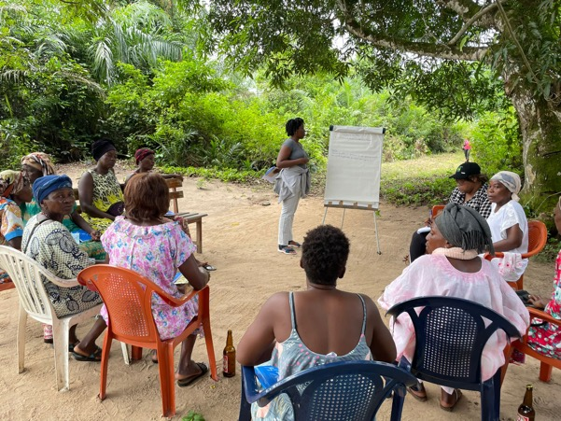
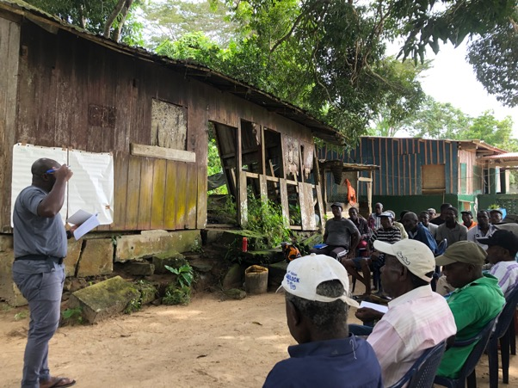
Images from FGDs

Slide 19

FGD budget and facilitator Description of Services for TNC contracts

